Slide 1



HACKSPRINT 2.O
Team Name: VisionX
Domain: EduTech
Category: Software
Project Title: SmartEdu

Slide 2
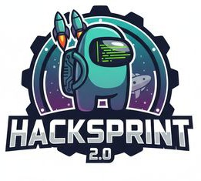
Challenge Statement
Current System Limitations
Existing e-learning platforms lack AI-driven personalization, adaptive analytics, and operate through fragmented tools for learning, testing, and guidance.
User Pain Points
Students face difficulty identifying weaknesses, experience delayed doubt resolution, and lack personalized guidance, leading to inefficient preparation and low confidence.
Technical Challenges
The system lacks automated evaluation, real-time analytics, predictive admission insights, and advanced technologies like Generative AI, ML, AR, and voice interfaces.
Operational Challenges
Manual performance tracking, disconnected course management, and poor scalability reduce efficiency and system integration for instructors and institutions.
Why This Problem Matters Now
Rising competition and learner expectations demand scalable, intelligent, data-driven, and real-time AI-powered education solutions.

Slide 3
Proposed Solution
Core Idea / Concept
SmartEdu System v1.0 is a unified AI-powered education platform that integrates learning, assessment, analytics, mentorship, and predictive guidance to deliver personalized, adaptive, and outcome-driven exam preparation.
Key Features
The platform offers AI-driven personalized learning paths, automated CBT and OMR evaluation, advanced analytics with adaptive study plans, real-time doubt resolution, AI-based college prediction, and immersive AR, voice navigation, and secure payment features.
How It Addresses the Challenges
SmartEdu replaces generic preparation with adaptive AI roadmaps, automates evaluation and analytics, provides real-time feedback, and centralizes all learning, testing, and communication within a single intelligent system.
Why This Solution Is Better Than Existing Ones
Unlike traditional platforms, SmartEdu delivers true AI personalization, faster feedback, integrated college guidance, higher engagement, and a scalable, future-ready digital learning ecosystem.

Slide 4
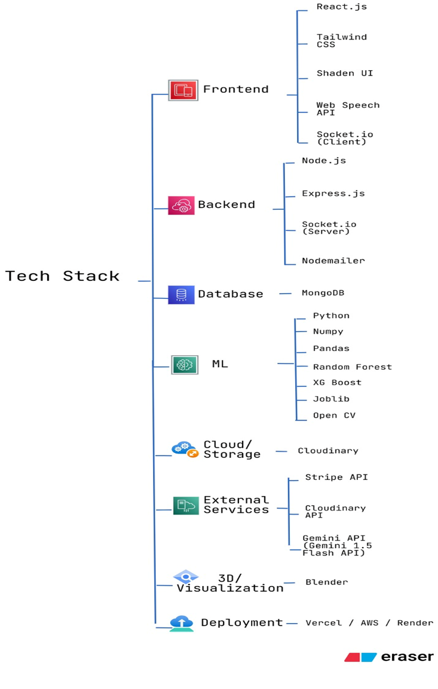
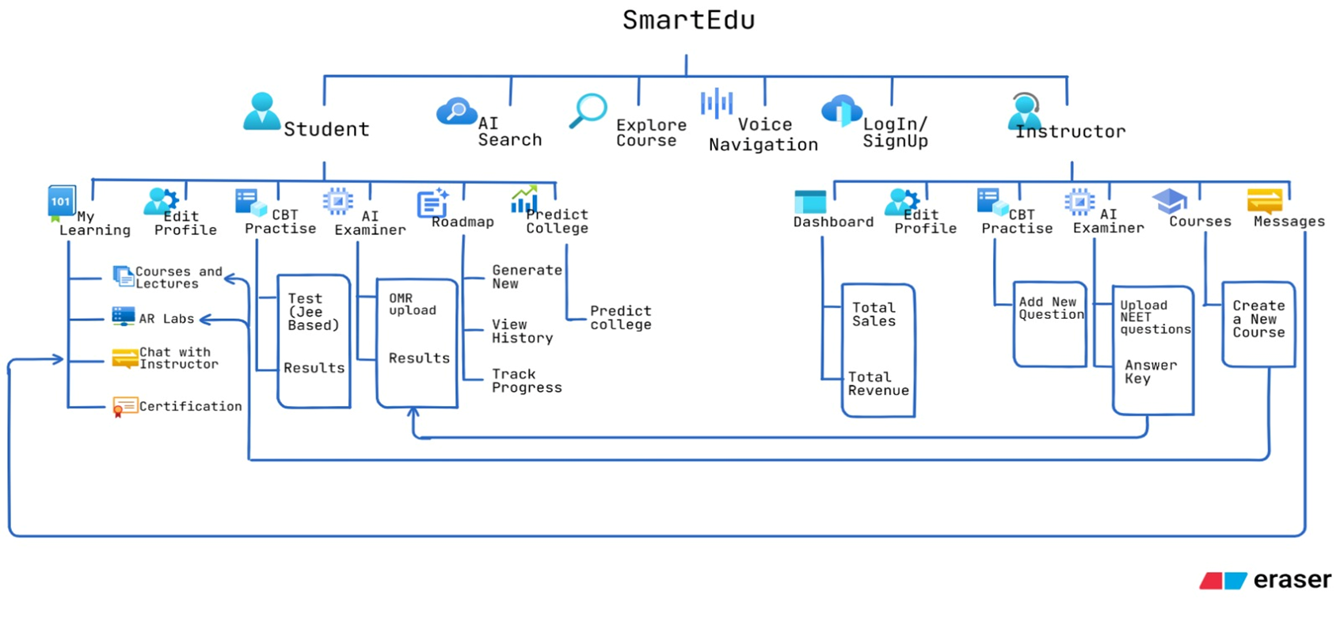
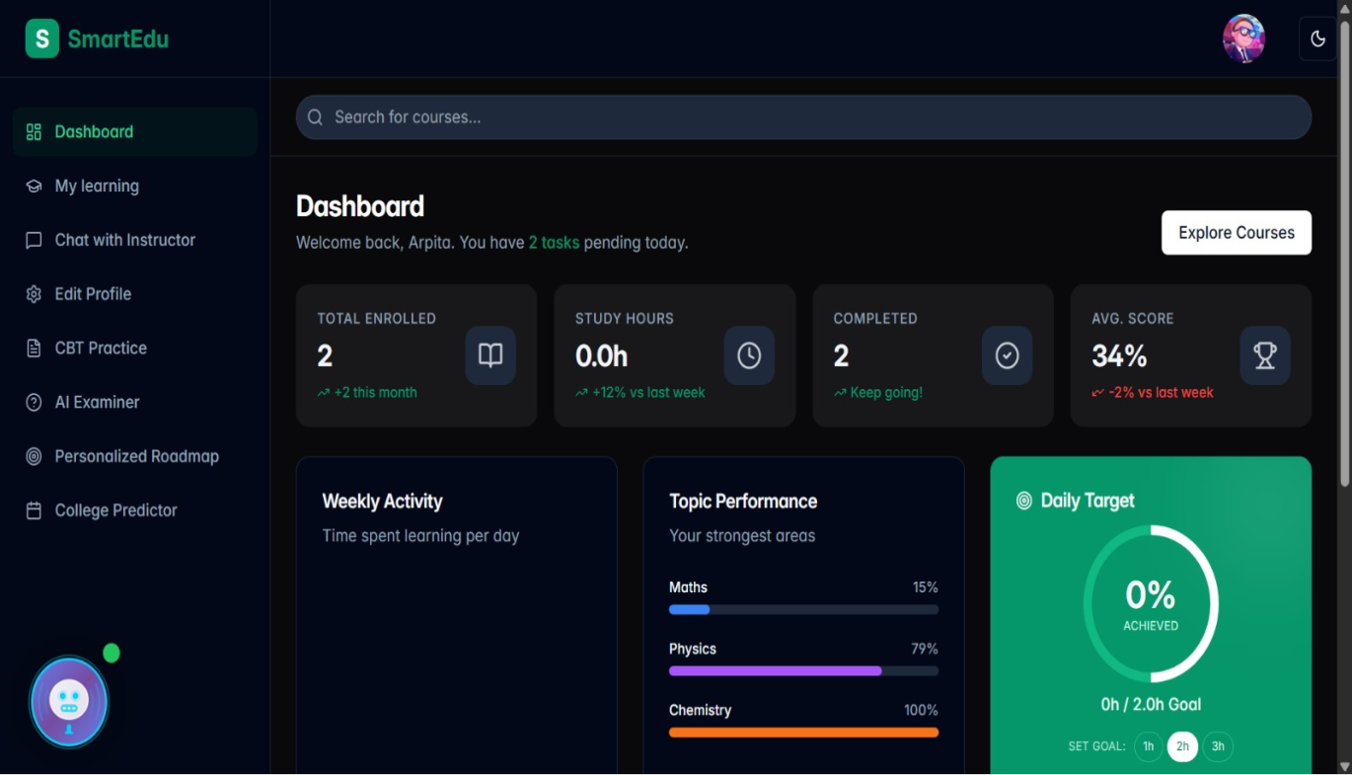
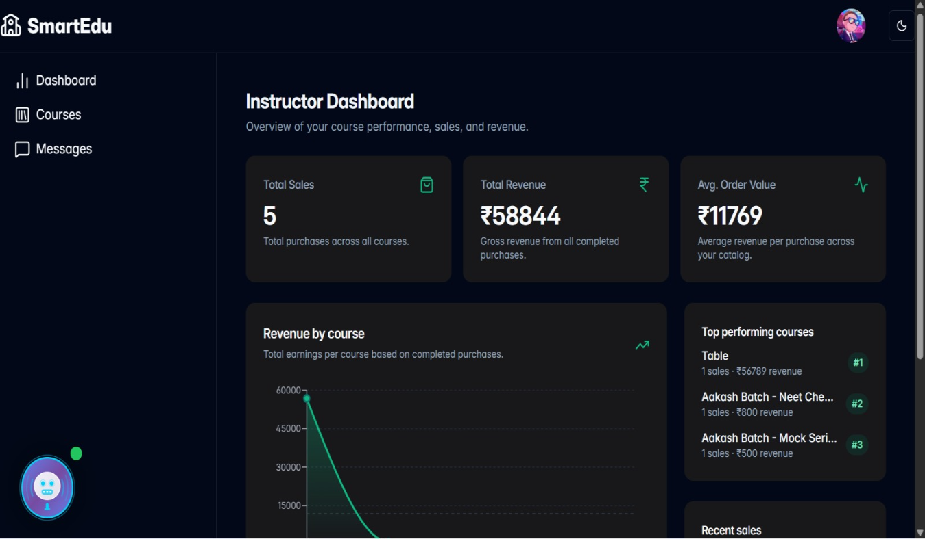
Technical Description

Slide 5
Impact & Benefits
1. Expected Impact on Users & Industry
SmartEdu System v1.0 transforms competitive exam preparation by enabling AI-driven personalization, improving student performance and confidence, and promoting a data-driven EdTech ecosystem.
2. Key Benefits
The platform delivers instant evaluations, high assessment accuracy, cost-effective operations, simplified all-in-one learning management, and inclusive accessibility through voice and AR-enabled interfaces.
3. Short-Term Value
Students quickly identify strengths and weaknesses, receive faster doubt resolution, and follow personalized study plans for efficient and focused exam preparation.
4. Long-Term Value
SmartEdu improves exam ranks and admission success while continuously optimizing learning outcomes through scalable, AI-powered insights adaptable to future educational needs.
5. Measurable Improvements
The system reduces evaluation time from hours to seconds, enhances accuracy and time management, and significantly increases student engagement and course completion rates.

Slide 6
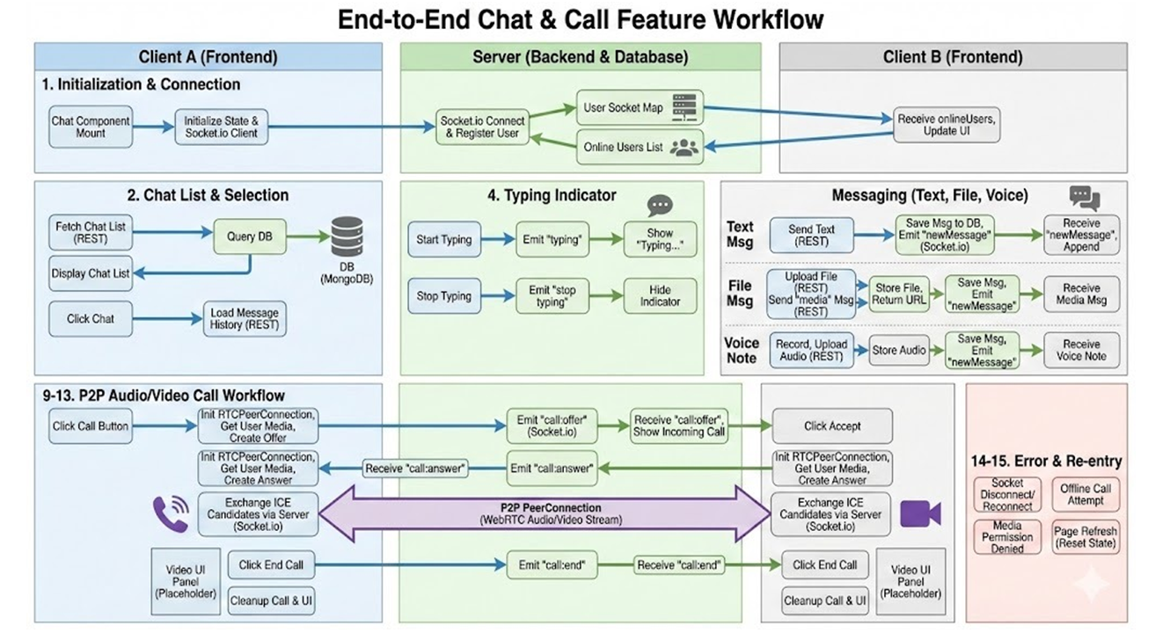
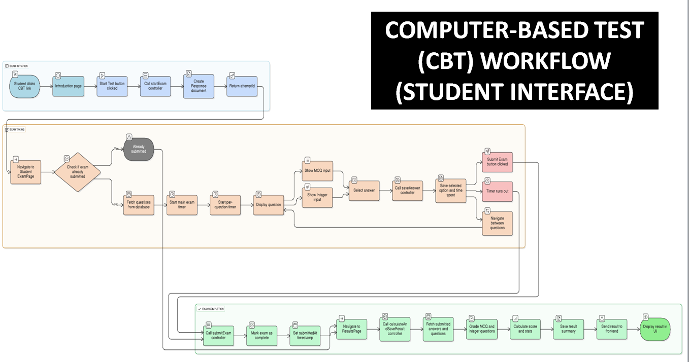
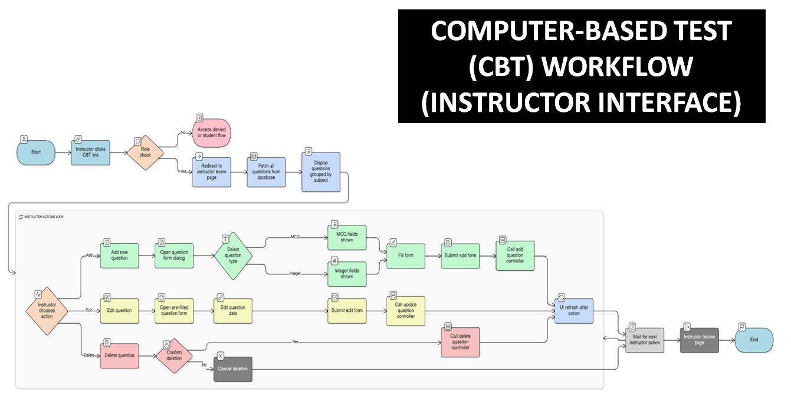
Feasibility & Viability
Technical Feasibility
SmartEdu System v1.0 is technically feasible using proven web technologies, cloud infrastructure, AI/ML models, Generative AI, secure APIs, and a modular architecture that ensures reliable implementation, integration, and maintenance.
Scalability & Future Enhancement Scope
The cloud-native and modular design of SmartEdu enables seamless scaling, easy onboarding of new exams and institutions, and future enhancements such as AI tutors, multilingual support, adaptive testing, mobile integration, and immersive AR/VR learning.

Slide 7
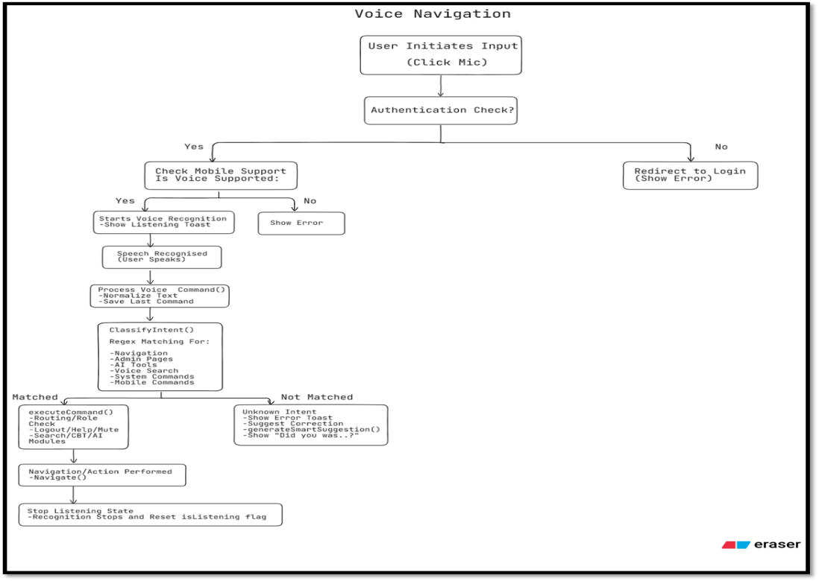
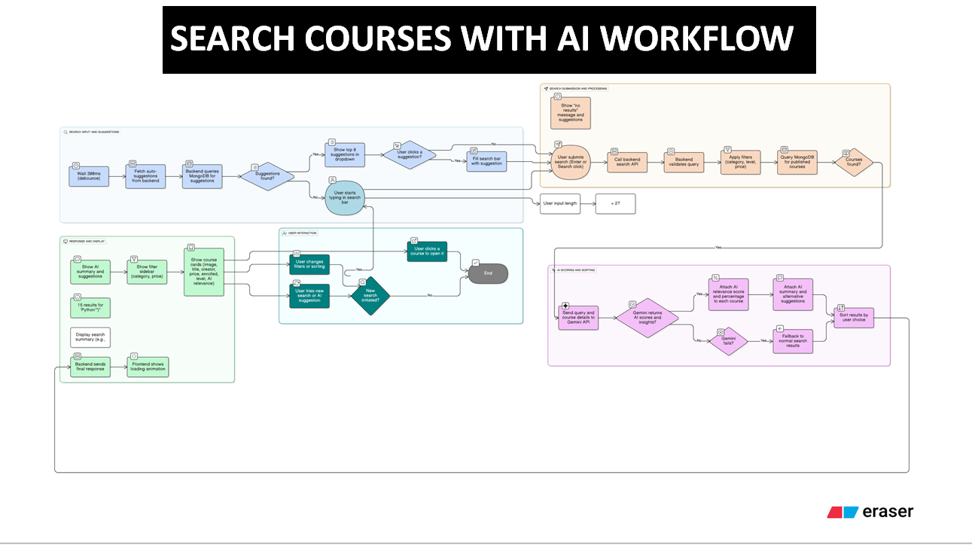
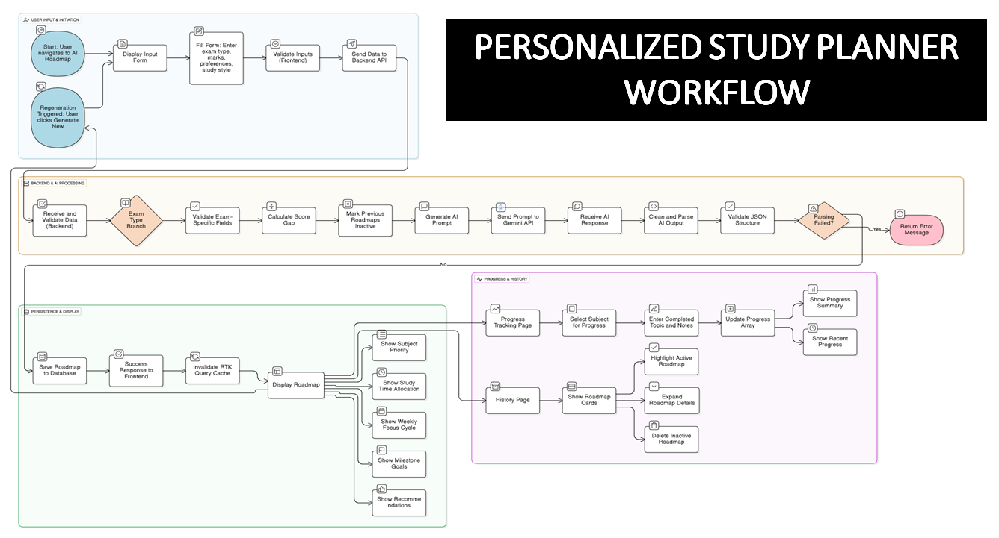
Competitor Analysis
Direct Competitors
Platforms like Unacademy, Physics Wallah, and BYJU’S offer strong content and live classes but lack deep AI personalization, adaptive analytics, real-time mentoring, and college prediction capabilities.
Indirect Competitors
Tools such as Udemy, Coursera, and Google Classroom address only partial needs like content delivery or assignment management without intelligent assessment, personalization, or exam-focused analytics.
Competitive Advantage of SmartEdu
SmartEdu uniquely integrates AI-driven personalized learning, automated testing and analytics, real-time mentoring, and college prediction into a single unified platform—capabilities not offered together by existing competitors.

Slide 8
Cost Estimate
Development Costs
Product development—including frontend/backend systems, AI/ML models for OMR and personalization, and AR/voice integrations—is estimated at ₹8–11 Lakhs.
Infrastructure & Cloud Costs
Cloud hosting, AI model APIs, storage, and scalability setup will require approximately ₹2.5–4.5 Lakhs per year.
Security & Payment Integration
Secure authentication, data protection, and payment gateway integration (e.g., Stripe) will cost around ₹1–1.5 Lakhs.
Testing & Deployment
Comprehensive QA, performance testing, CI/CD pipeline setup, and deployment will require ₹1–1.5 Lakhs.
Operations & Maintenance
Ongoing platform maintenance, updates, monitoring, and technical support are estimated at ₹1.5–2.5 Lakhs per year.
Total Estimated Cost
The total cost to convert the prototype into a production-ready SmartEdu System v1.0 is ₹10–14 Lakhs initially, with ₹3–5 Lakhs annually for operations and scaling.

Slide 9

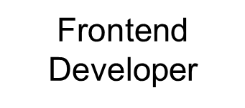

Team Name: VisionX
Somsubhra Dalui | Heritage Institute of Technology | West Bengal
Prayas Mondal | Heritage Institute of Technology | West Bengal
MD Afzal Alam | Heritage Institute of Technology | West Bengal
Ankita Nath | Heritage Institute of Technology | West Bengal
Arpita Nath | Heritage Institute of Technology | West Bengal
Team Leader
Male
AI/ML Developer
Male
Product Lead
Male
Backend Developer
Female

